Slide 1

BrachyVision
Team M.A.R.K.
Project Update 1
Michael Rees
Ananya Zutshi
Rhea Chitalia
Karthika Raja

Slide 2
Agenda
Product recap
Hardware
Software
Transducer
Testing
Progress
Future Directions
Budget
Timeline

Slide 3
Recap: Project Specifications
Task:
Design a brachyseed/transducer combination that can induce brachyseed oscillations to allow for visualization via ultrasound
why? → prostate cancer
Method:
Induce a time varying magnetic field to cause magnetic attraction/repulsion of the brachyseeds, causing them to oscillate

Slide 4
Hardware
Specs:
-Convert wall AC power to usable DC
-Power Arduino
-Output PWM signal should be regulated and amplified to electromagnet

Slide 5
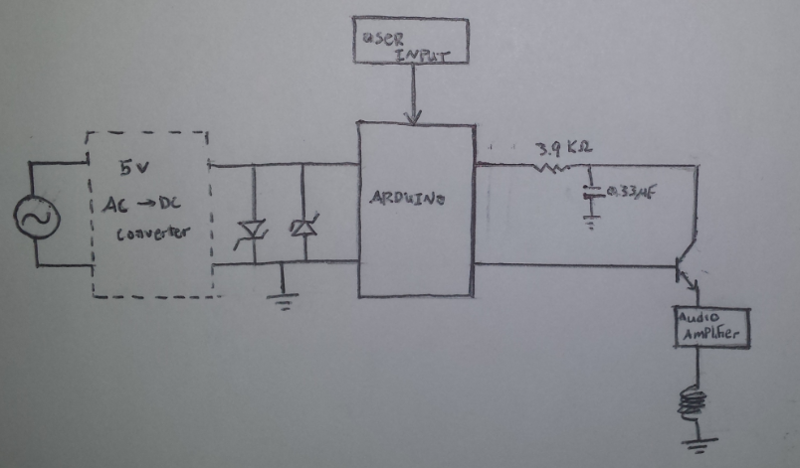
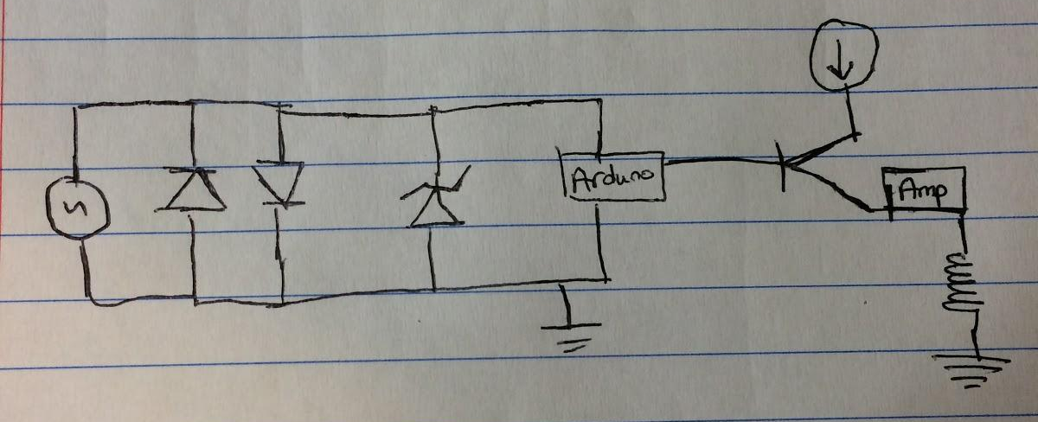
Hardware - Circuit Diagram
Amp Output
LPF
Freq Output
Amplifies Current
Wall Power
Full Wave Rectifier.
Purchased
Clipper Circuit
Transducer
Notes:
AC power source
Goes through AC DC converter to become 5V DC
Zener diode (doesn’t need to be powered) clipping for 5V to ensure we don’t blow up the Arduino
Goes into Arduino
output is a pulse width modulation signal
This signal is going into a voltage dependent current source-BJT to be relayed
the current is amplified to a working range of 0.5 Amps to then power the electromagnet to produce the magnetic field
All of the hardware will be housed in the console

Slide 6
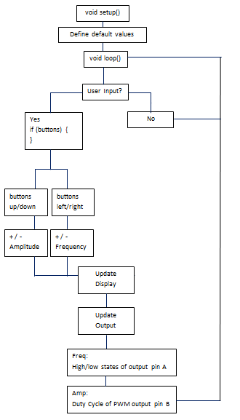
Software
software flowchart

Slide 7
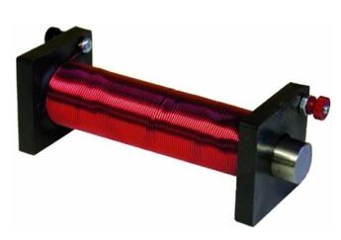
Transducer
electromagnet in rectal probe
why rectal probe?
→ smaller transducer-to-prostate distance

Slide 8
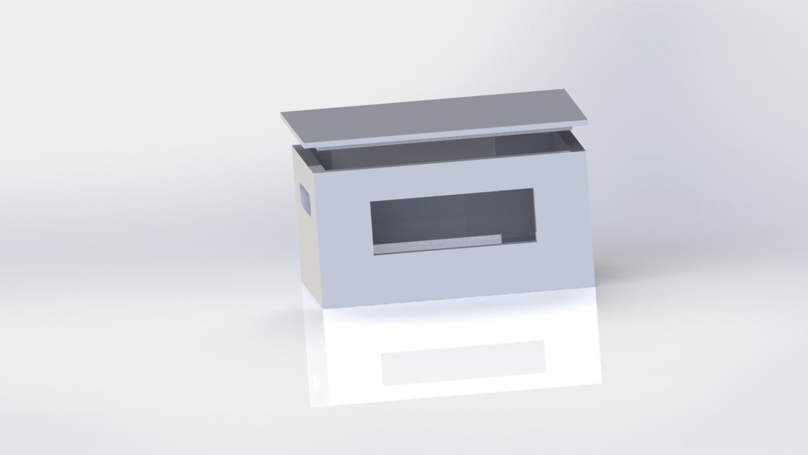
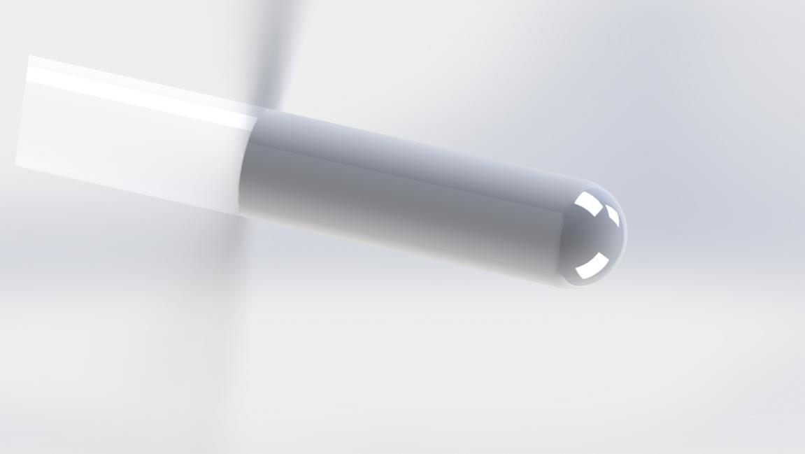
Physical Enclosure
Notes:
enclosure with openings for wires between PCB and rectal probe (contains electromagnet), user interface and knobs
probe that will be 3D printed in 2 parts so that electromagnet can fit

Slide 9
Testing
Testing so far:
Electromagnet from speakers? No
Make electromagnets? Fun, but no
Thanks Matt Brown
Buy electromagnet
Future:
Make tissue mimicking phantom
Embed stir bars
Stimulate with electromagnet
Use ultrasound machine to visualize and calculate frequency and amplitude
EMF meter to measure the strength of the magnetic field
First pass testing date: 10/29 or 10/31

Slide 10
Progress thus far
We have:
completed circuit diagram
software flowchart
testing protocols
we now have everything we need to create prototype, other than our electromagnet

Slide 11
Future Directions
-Actual assembly of prototype
-Testing (aiming for 10/29, possibly 10/31)
-3D modeling/printing of new probe
we need it to house more tech
-3D modeling/printing of Arduino encasing

Slide 12
Budget Breakdown
-Stir bars: $26
-Electromagnet: $34
-Speakers: $12
-Audio amplifier: $7
-Potentiometers (unnecessary): $10
Total: $89 (out of $400)

Slide 13
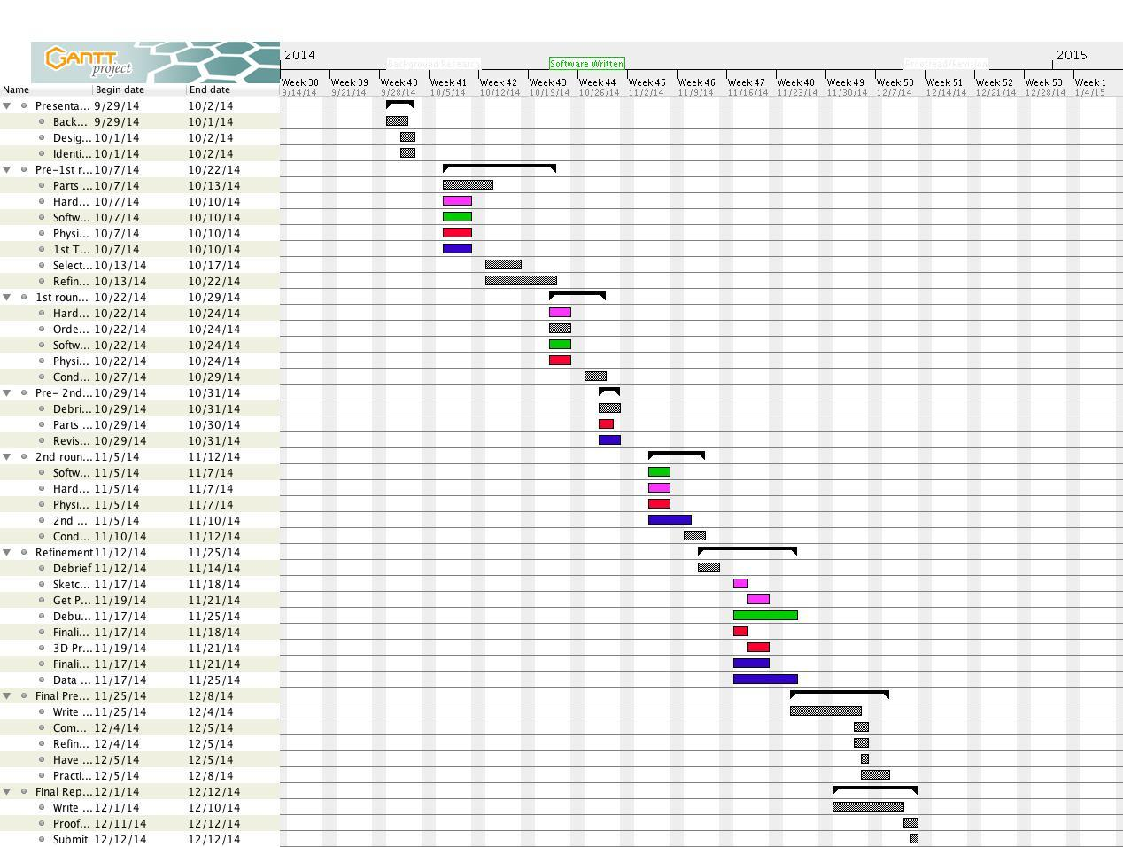
Gantt Chart
Notes:
Grey- everyone
Pink- hardware
Green- software
Red- physical design
Blue- testing

